Slide 1
NAT GATEWAY/NAT INSTANCE

Slide 2
What is NAT?
Network Address Translation is the network process that is the task of translating and assigning the private network model, to the global IP address to access internet services.
The same step is repeated, to convert a public IP address into a private IP address, to provide the received data and information from the internet. The NAT process helps with the conservation of IP addresses and provides better security.

Slide 3
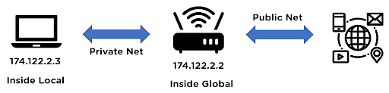
Addresses of NAT
NAT addresses can be differentiated as inside and outside addresses, where inside address refers to the private addresses to be translated. The outside addresses refer to as the ones used to access the internet.

Slide 4
Inside local address: This IP address represents the host of the private network. This address cannot be used by a private network to access the internet directly.
Inside global address: This IP address represents the whole private network, by using a globally recognized public IP address. It is used to access the internet services for the private network.

Slide 5
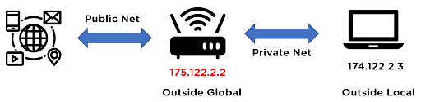
Outside global address: This IP address represents the outside network address for the host before the NAT translation process.
Outside local address: This IP address represents the actual address representing the host on the internet, after the NAT translation process.

Slide 6
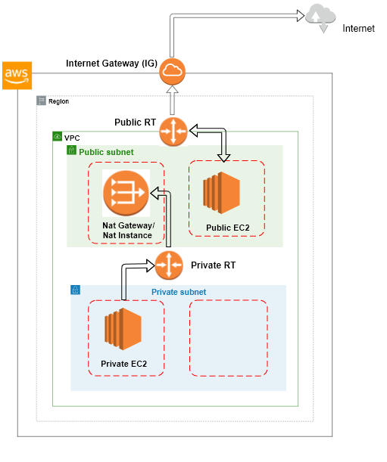
NAT GATEWAY/NAT INSTANCE

Slide 7
We have 2 kinds of NAT devices:
NAT Gateway
NAT Instance
Nat Gateway
NAT stands for Network Address Translation.
A NAT Gateway is a device used to enable instances in a private subnet to connect to the internet or other AWS services.
It prevents the internet from initiating connections with the instances present in the private subnet.
Charged for each hour that your NAT gateway is available and each Gigabyte of data that it processes.
NAT gateways are not supported for IPv6 traffic.
A NAT gateway supports 5 Gbps of bandwidth and automatically scales up to 45 Gbps.
It is AWS managed service that has higher bandwidth, better availability, and no admin work required.
NAT is created in a specific AZ and uses an EIP and No security group to manage/required

Slide 8
NAT Instance
NAT Instance uses Amazon Linux AMIs.
NAT Instance limit depends on your instance type limit for the region.
NAT Instance does not support IPv6 traffic.
NAT Gateway usage is charged to the customer on an hourly basis.
NAT Gateway does not support IPv6 traffic.
AWS recommends the usage of NAT Gateway since they provide better availability and bandwidth over NAT Instances.
To create a NAT instance, we can choose AMI amzn-ami-vpc-nat.
You must disable source/destination checks on the NAT instance.

Slide 9
Attribute | NAT gateway | NAT instance
Availability | Highly available. NAT gateways in each Availability Zone are implemented with redundancy. Create a NAT gateway in each Availability Zone to ensure zone-independent architecture. | Use a script to manage failover
Bandwidth | Scale up to 100 Gbps. | Depends on the bandwidth of the instance type.

Slide 10
Maintenance | Managed by AWS. You do not need to perform any maintenance. | Managed by you, for example, by installing software updates or operating system patches on the instance.
Cost | Charged depending on the number of NAT gateways you use, duration of usage, and amount of data that you send through the NAT gateways. | Charged depending on the number of NAT instances that you use, duration of usage, and instance type and size.
Type and size | Uniform offering; you don’t need to decide on the type or size. | Choose a suitable instance type and size, according to your predicted workload.

Slide 11
Public IP addresses | Choose the Elastic IP address to associate with a public NAT gateway at creation. | Use an Elastic IP address or a public IP address with a NAT instance. You can change the public IP address at any time by associating a new Elastic IP address with the instance.
Private IP addresses | Automatically selected from the subnet's IP address range when you create the gateway. | Assign a specific private IP address from the subnet's IP address range when you launch the instance.
Security groups | You cannot associate security groups with NAT gateways. You can associate them with the resources behind the NAT gateway to control inbound and outbound traffic. | Associate with your NAT instance and the resources behind your NAT instance to control inbound and outbound traffic.

Slide 12
Bastion servers | Not supported. | Use as a bastion server.

Slide 13
CREATE NAT GATEWAY
Open the Amazon VPC console at https://console.aws.amazon.com/vpc/
In the navigation pane, choose NAT Gateways, Create NAT Gateway.
Specify the subnet in which to create the NAT gateway, and select the allocation ID of an Elastic IP address to associate with the NAT gateway.
[Add a tag] Choose Add tag and do the following:
For Key, enter the key name.
For Value, enter the key value.
Choose Create a NAT Gateway.
The NAT gateway displays in the console. After a few moments, its status changes to Available, after which it’s ready for you to use.
After you’ve created your NAT gateway, you must update your route tables for your private subnets to point internet traffic to the NAT gateway. We use the most specific route that matches the traffic to determine how to route the traffic (longest prefix match).
Open the Amazon VPC console at https://console.aws.amazon.com/vpc/
In the navigation pane, choose Route Tables.
Select the route table associated with your private subnet and choose Routes, Edit.
Choose Add another route. For Destination, enter 0.0.0.0/0. For Target, select the ID of your NAT gateway.
Choose Save.
To ensure that your NAT gateway can access the internet, the route table associated with the subnet in which your NAT gateway resides must include a route that points internet traffic to an internet gateway.

Slide 14
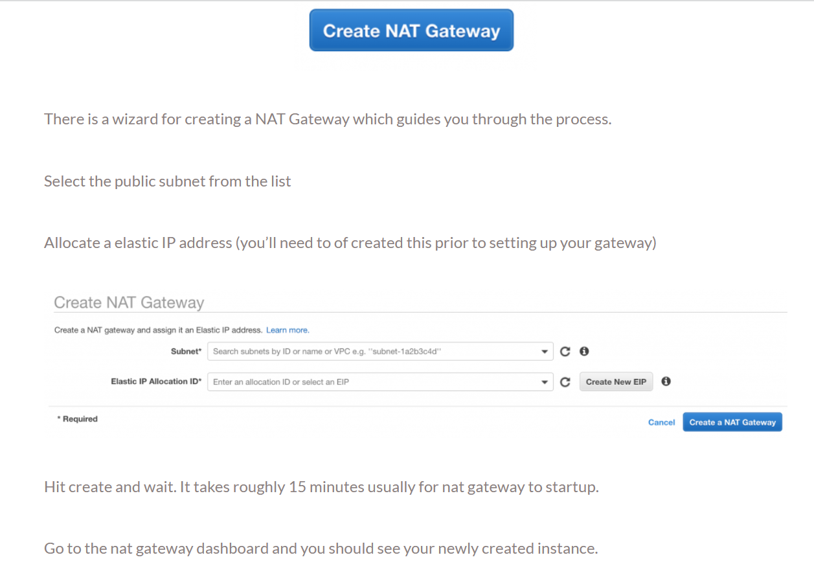

Slide 15
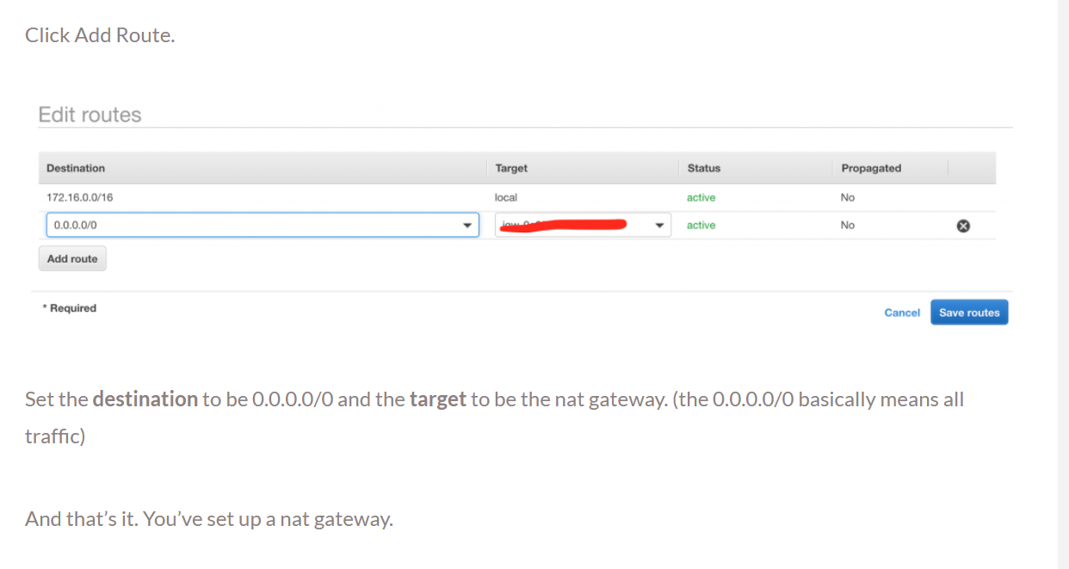

Slide 16
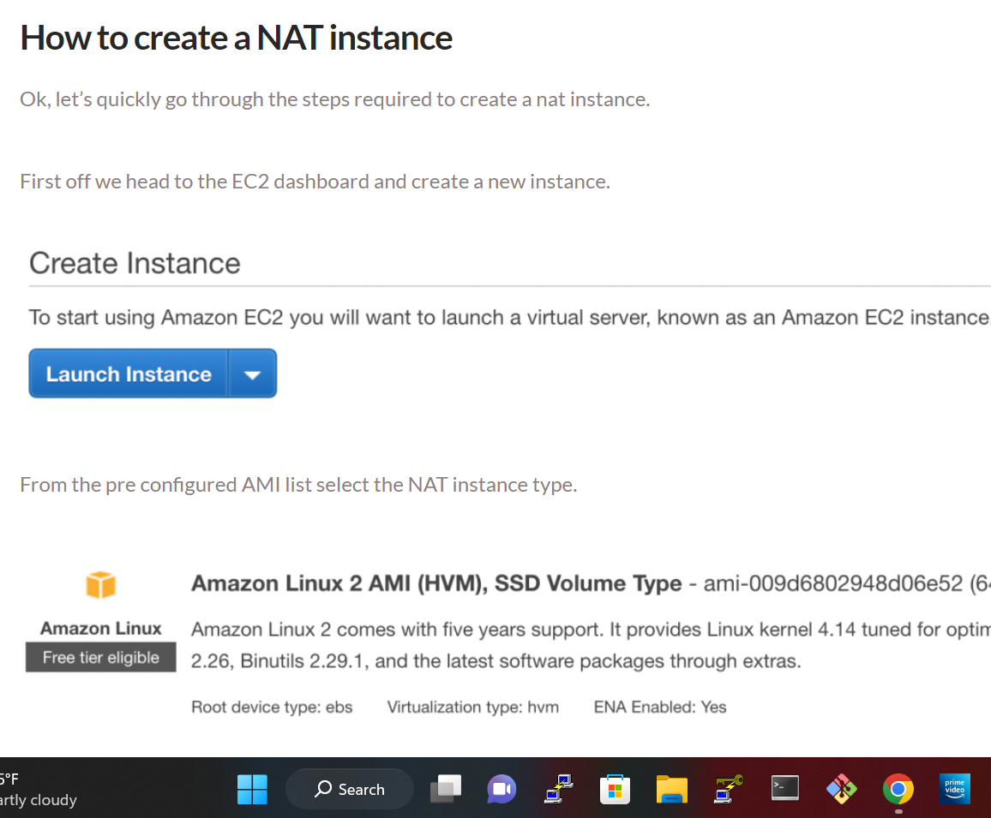

Slide 17
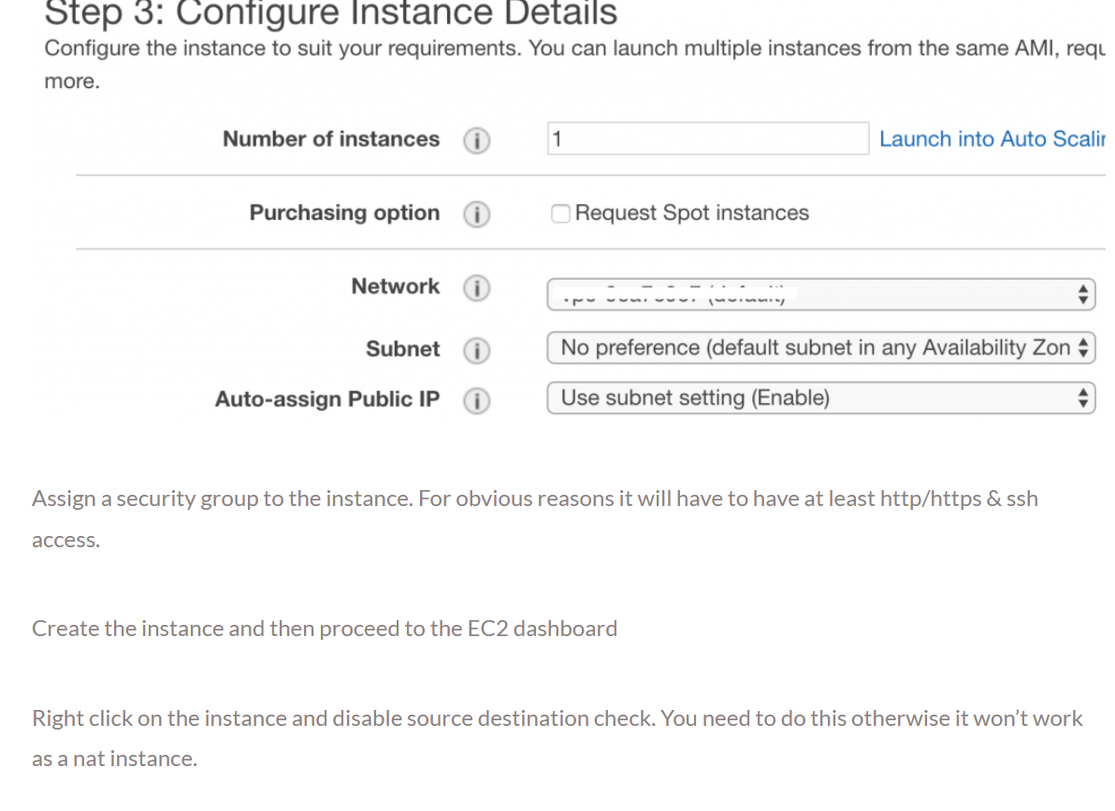

Slide 18
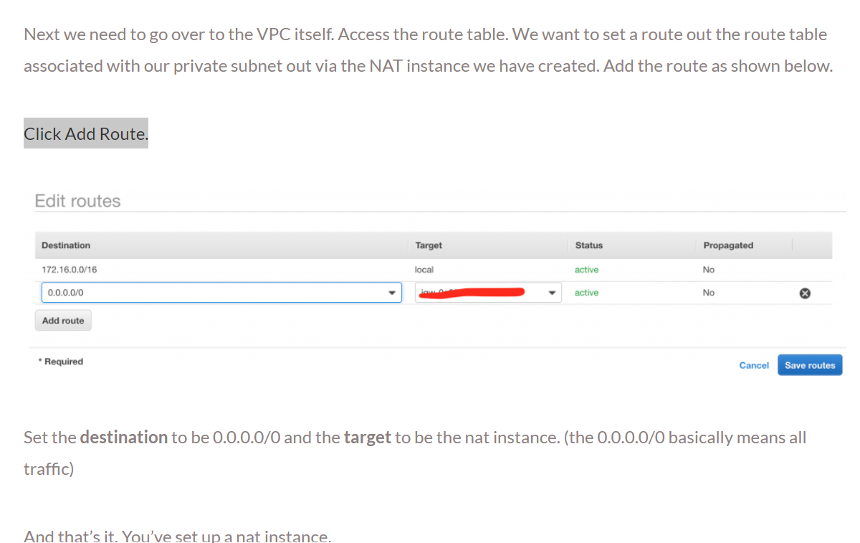

Slide 19
INTERVIEW QUESTIONS:
However will NAT work?
Ans : Basically, NAT permits one device, like a router, to act as AN agent between the net (or public network) and an area network (or personal network), which suggests that solely one distinctive informatics address is needed to represent a whole cluster of computers to something outside their network. confer with however NAT Works for a lot of data

Slide 20
aws nat gateway vs nat instance pricing – which is cheaper? This entirely depends on the amount of usage. But if you compare like for like, then gateways are more cost effective.
Nat gateway instance high availability – high availability is easier to achieve via a nat gateway than a nat instance. It is also much easier to maintain.
Nat gateway vs internet gateway – two different things that shouldn’t be confused. A internet gateway provides access to the internet for your entire VPC. Where as a gateway provides internet access for a subnet.

Slide 21
Thank you

